Slide 1
AI-Powered Insurance Policy Information Chatbot Background

Slide 2
Problem Statement
Insurance companies offer a variety of policies, including health, life, auto, and home insurance. Customers often have questions about the different types of policies, coverage options, premiums, and claim processes.
Providing timely and accurate information is crucial for customer satisfaction and decision-making.
An AI-powered chatbot can assist customers by answering their queries about insurance policies, helping them understand their options and make informed decisions.

Slide 3
Objective
Developed a chatbot that can assist customers with queries related to different types of insurance policies offered by the company. The chatbot should understand natural language, provide accurate responses, and guide customers through the information they need.

Slide 4
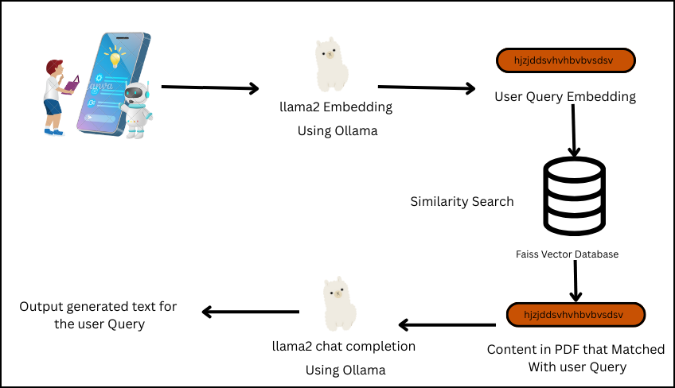
Work Flow
User Query

Slide 5
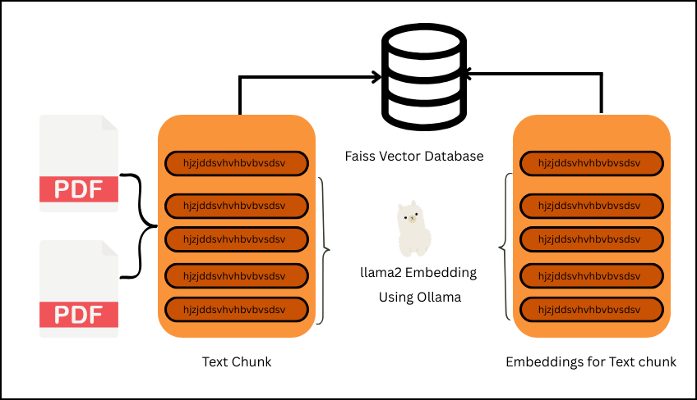
Training

Slide 6
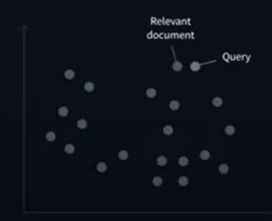
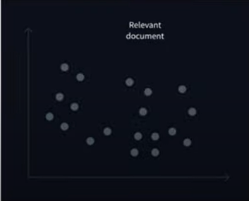
FAISS
Used for Similarity Search
It has a Special Data Structure called an index that allows one to find which embedding (pdf chunk content) are similar to an input embedding(user Query)
Embedding Space

Slide 7
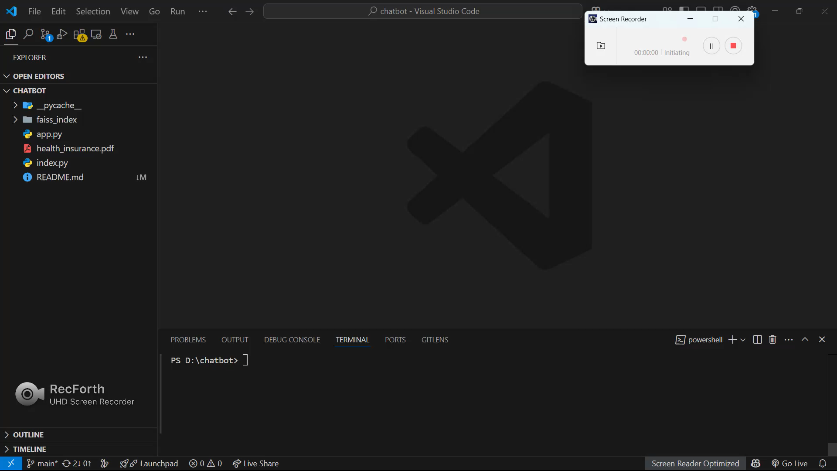
Demo

